Slide 1



Attentional Choice Biases in Losses: an aDDM Puzzle
Brenden Eum
Stephen Gonzalez
Antonio Rangel

Slide 2
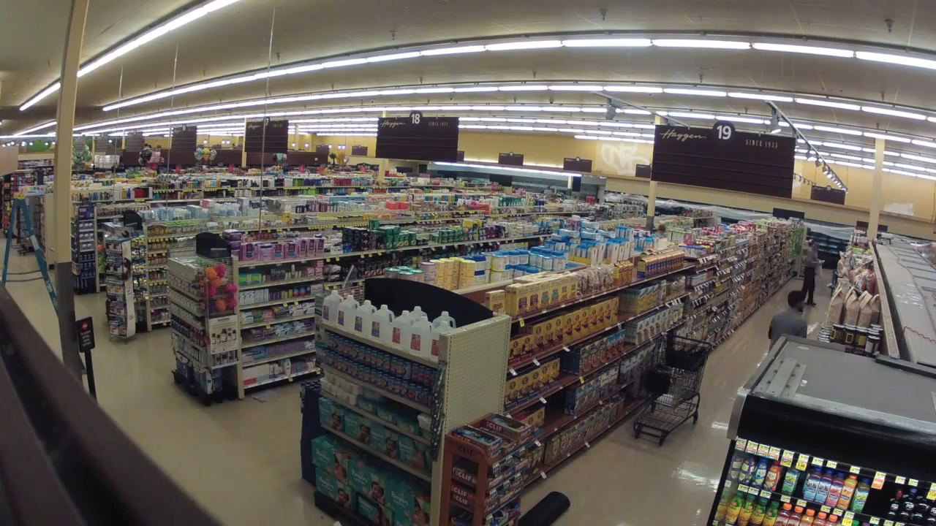


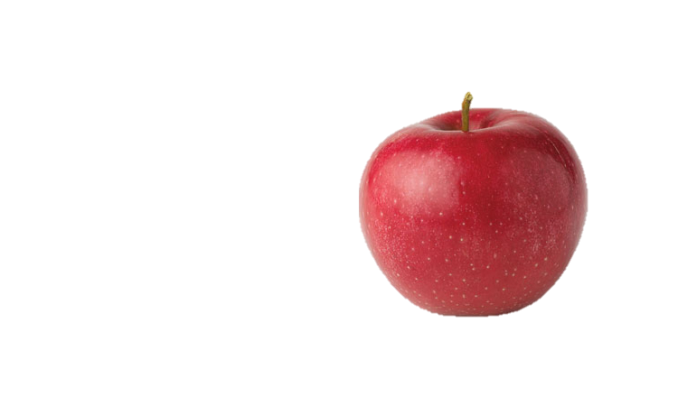

Slide 3
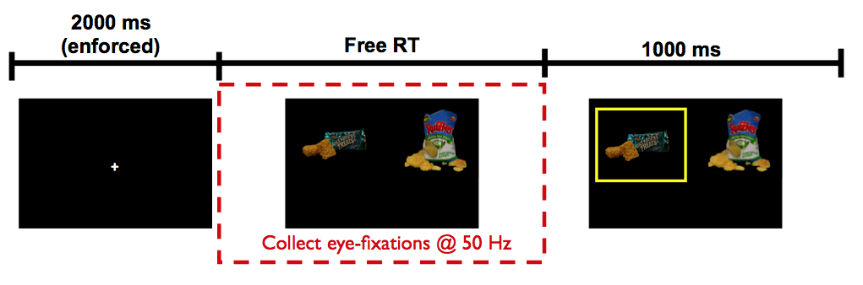
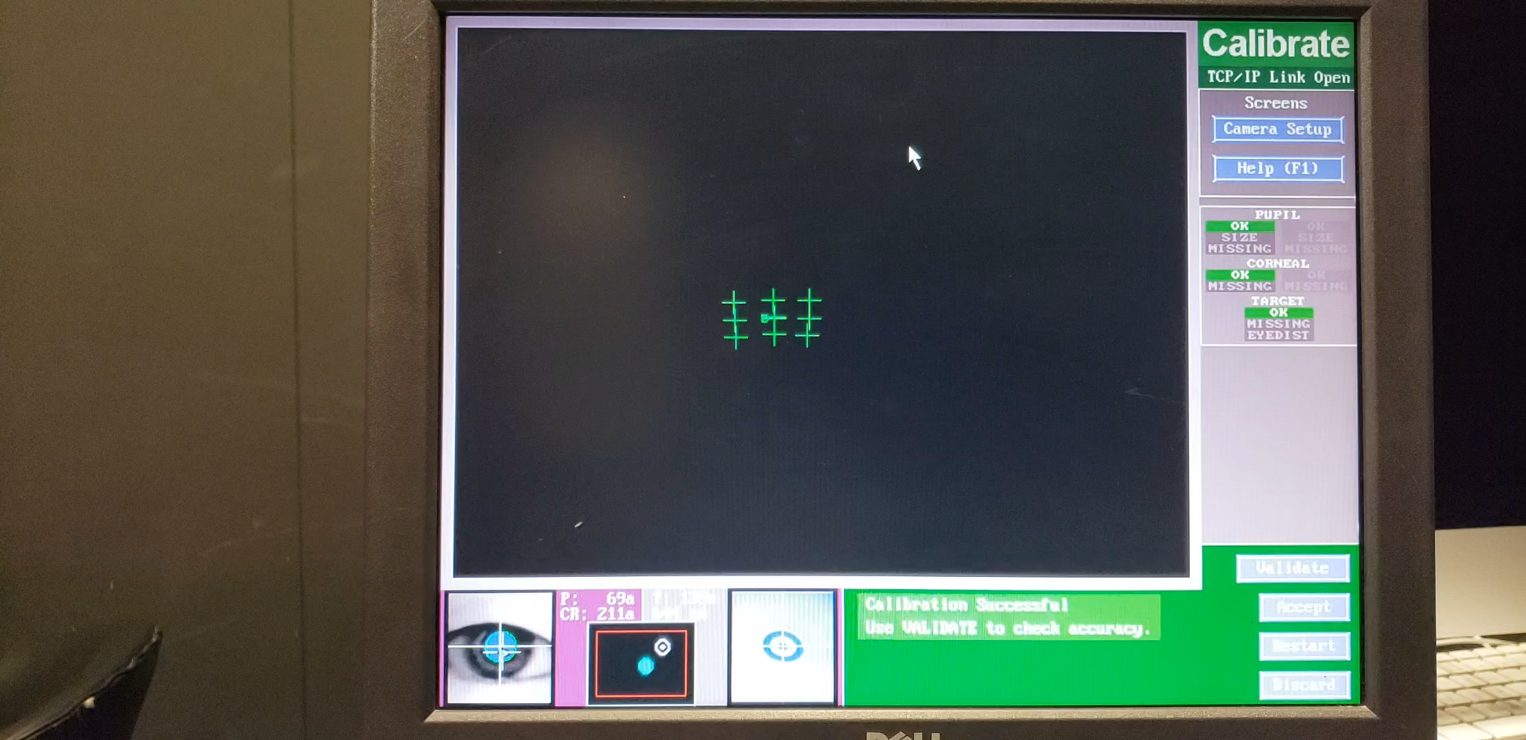
Krajbich, Armel, Rangel (2010, Nat Neuro)

Slide 4
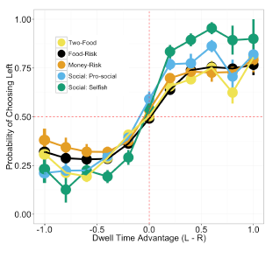
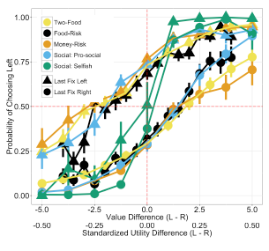
Net Fixation Bias
Last Fixation Bias
Smith, Krajbich (2018, J Exp Psychol Gen)
Notes:
multiple domains

Slide 5
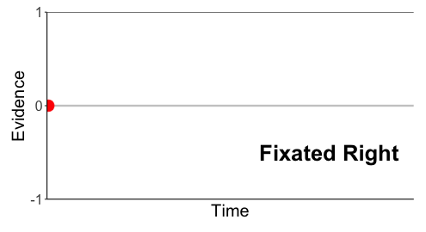
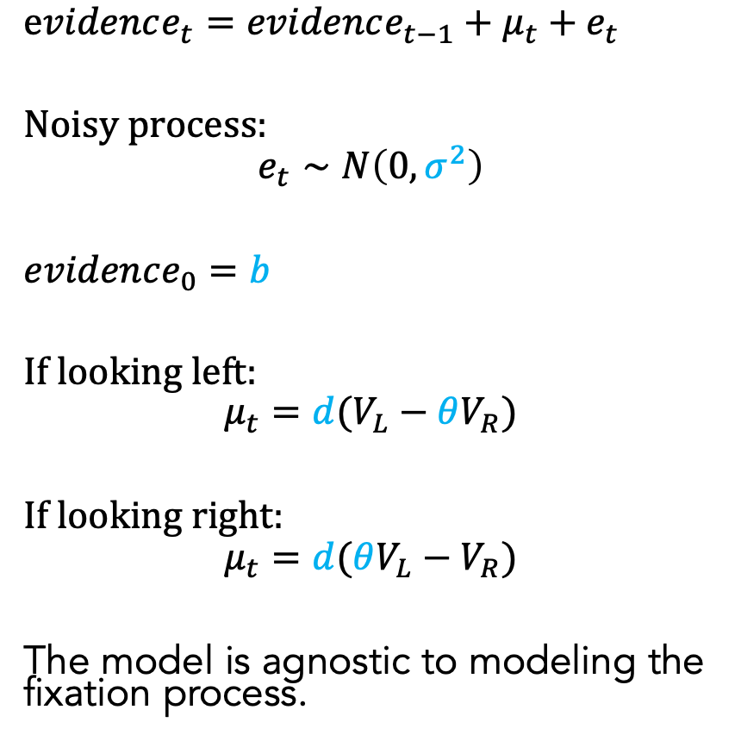
Attentional Drift-Diffusion-Model (aDDM)
$evidence_{t}=evidence_{t−1}+μ_{t}+e_{t}$
Noisy process:
$$e_{t}∼N\left(0, σ^{2}\right)$$
$evidence_{0}=b$
If looking left:
$$μ_{t}=d(V_{L}−θV_{R})$$
If looking right:
$$μ_{t}=d(θV_{L}−V_{R})$$
The model is agnostic to modeling the fixation process.
Pick Left
Pick Right
Notes:
noisy
bias
drift: ddm in value based decisions: evidence accumulated is value comparison
drift
sim
explain fixation sampling process

Slide 6
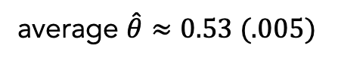
aDDM Predictions
average $\hat{θ}≈0.53 (.005)$
1. Attentional Discounting
2. Net Fixation Bias
3. Last Fixation Bias
Bhatnagar, Orquin (2022, J Exp Psychol Gen)
Smith, Krajbich (2018, J Exp Psychol Gen)

Slide 7
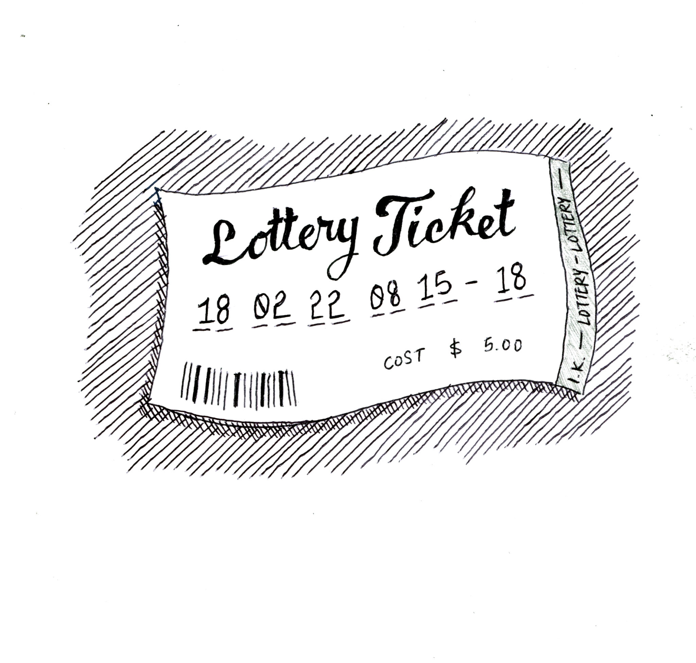
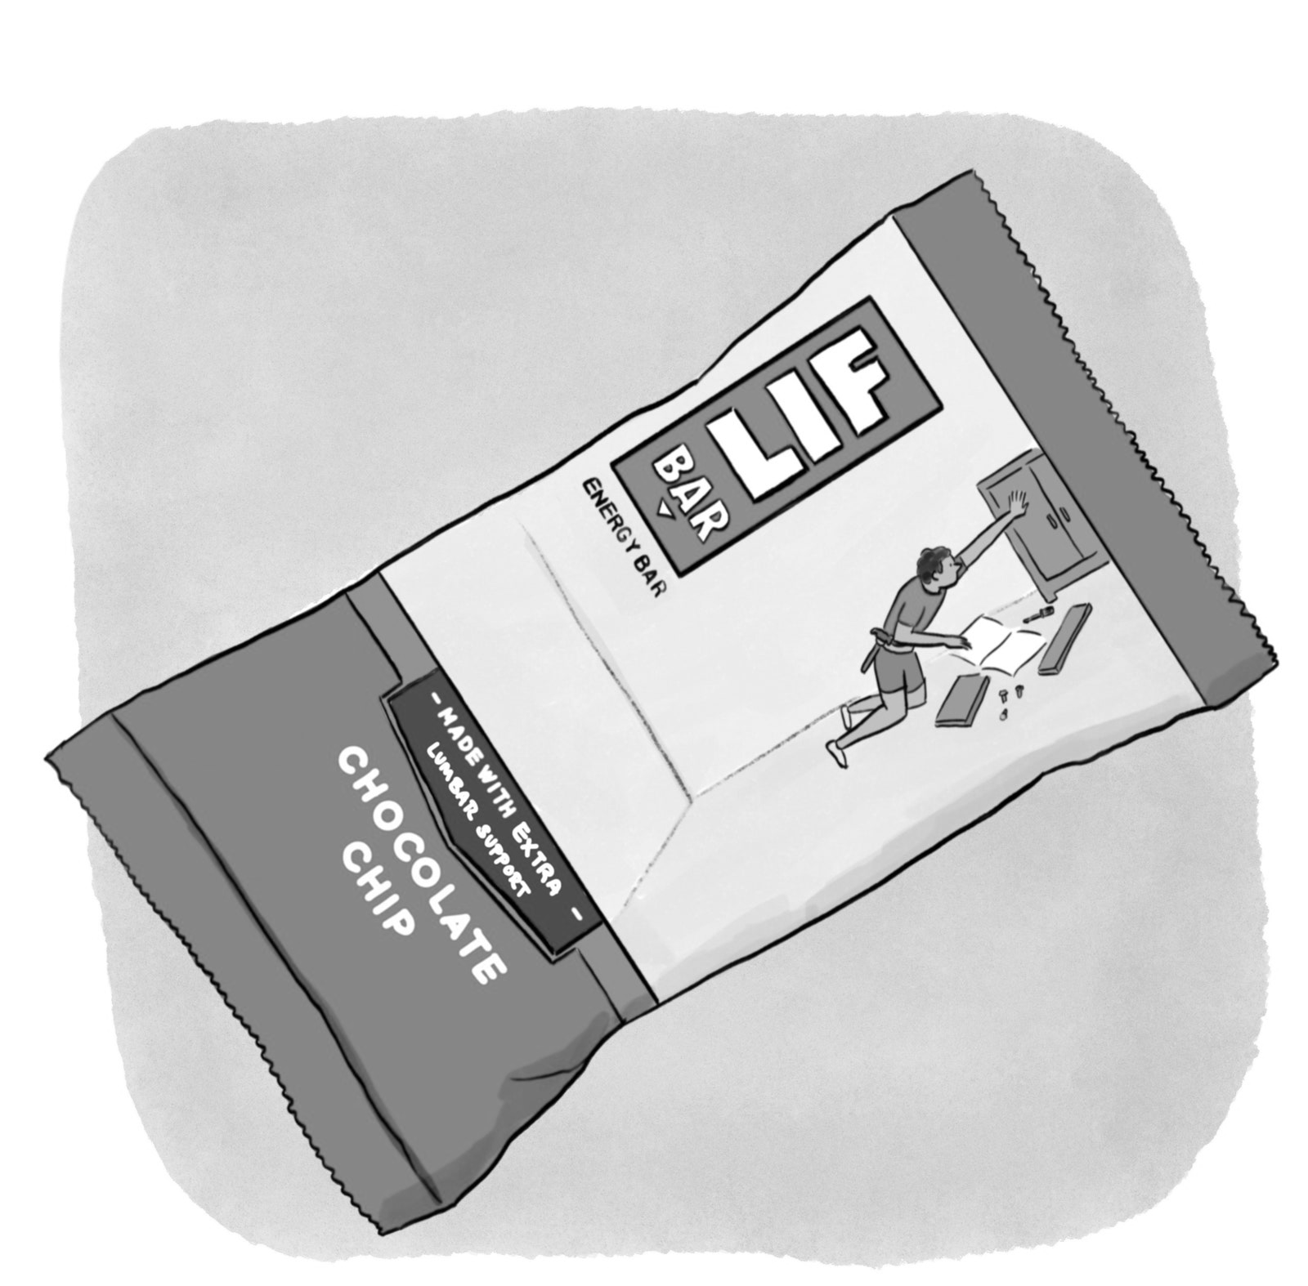
See Smith, Krajbich (2018, J Exp Psychol Gen); Bhatnagar, Orquin (2022, J Exp Psychol Gen); Fiedler, Glöckner (2012, Front Psychol)
Brenden Eum

Slide 8
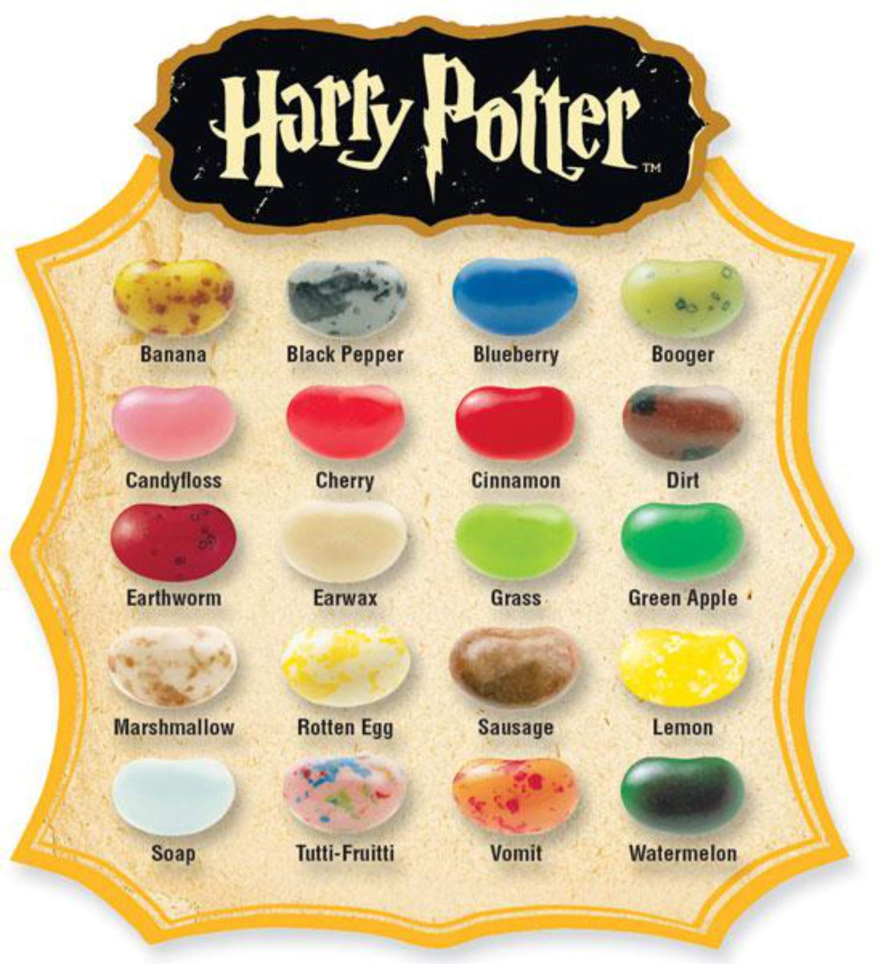
Brenden Eum

Slide 9
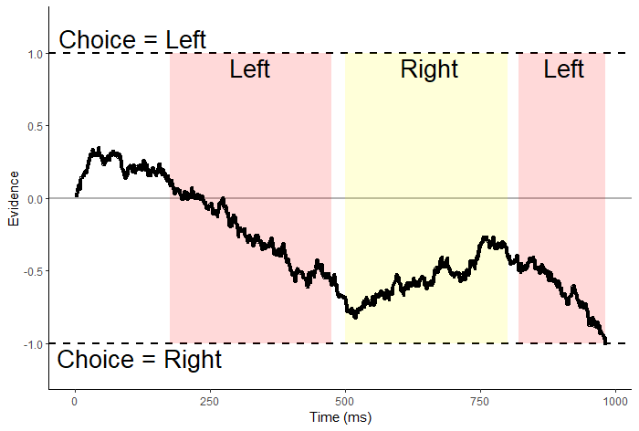
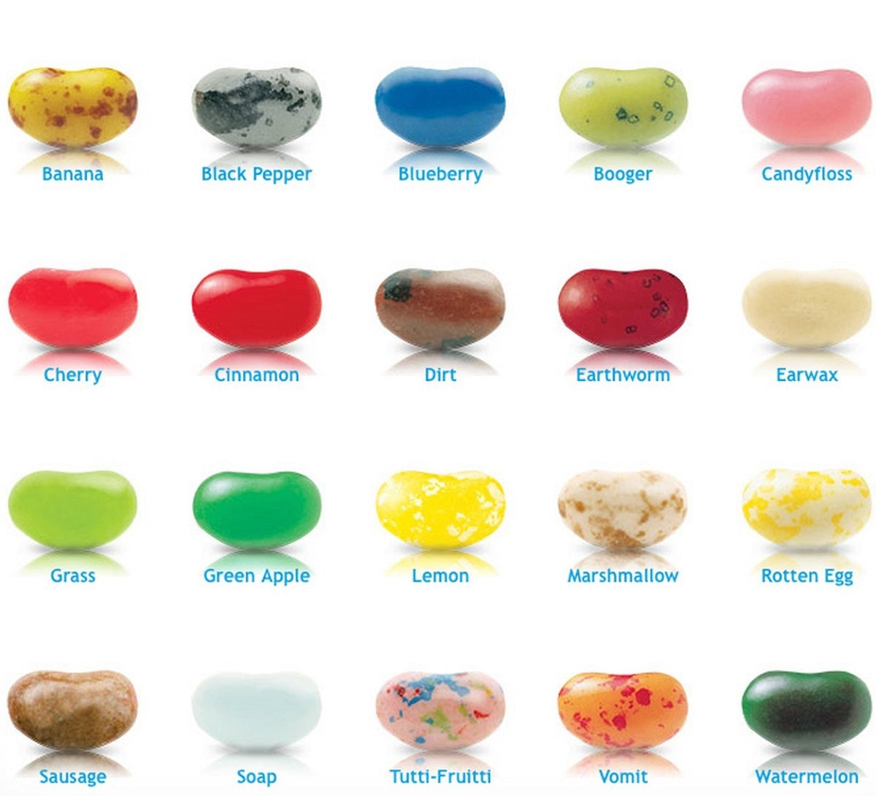
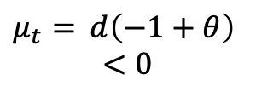
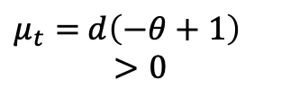
Suppose $V_{L}=−1, V_{R}=−1,$ and $θ∈(0,1)$.
$evidence_{t}=evidence_{t−1}+μ_{t}+e_{t}$
$μ_{t}=$ $d\left(−1+θ\right)$
$<0$
$μ_{t}=$ $d\left(−θ+1\right)$
$>0$

Slide 10
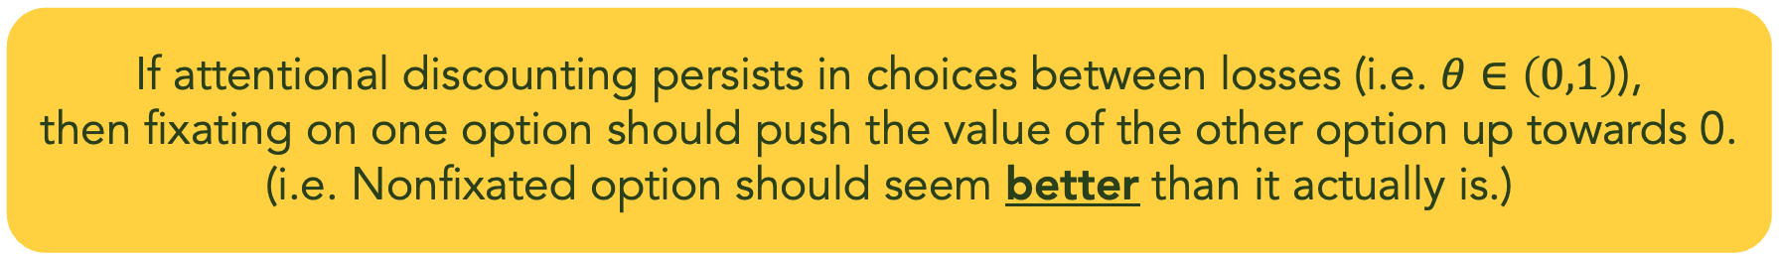
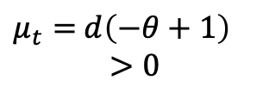
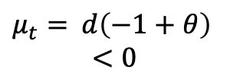
Suppose $V_{L}=−1, V_{R}=−1,$ and $θ∈(0,1)$.
$evidence_{t}=evidence_{t−1}+μ_{t}+e_{t}$
$μ_{t}=$ $d\left(−1+θ\right)$
$<0$
$μ_{t}=$ $d\left(−θ+1\right)$
$>0$
If attentional discounting persists in choices between losses (i.e. $θ∈\left(0,1\right)$),
then fixating on one option should push the value of the other option up towards 0.
(i.e. Nonfixated option should seem better than it actually is.)

Slide 11
Attentional Choice Biases
Net Fixation Bias
Last Fixation Bias
Last fix. right
Last fix. left
P(Left Chosen)
P(Left Chosen)
Final Time Advantage Left (ms)
Left Rating - Right Rating

Slide 12
Attentional Choice Biases
Should Flip!
Net Fixation Bias
Last Fixation Bias
Last fix. right
Last fix. left
P(left chosen)
P(Left Chosen)
Final Time Advantage Left (ms)
Left Rating - Right Rating

Slide 13
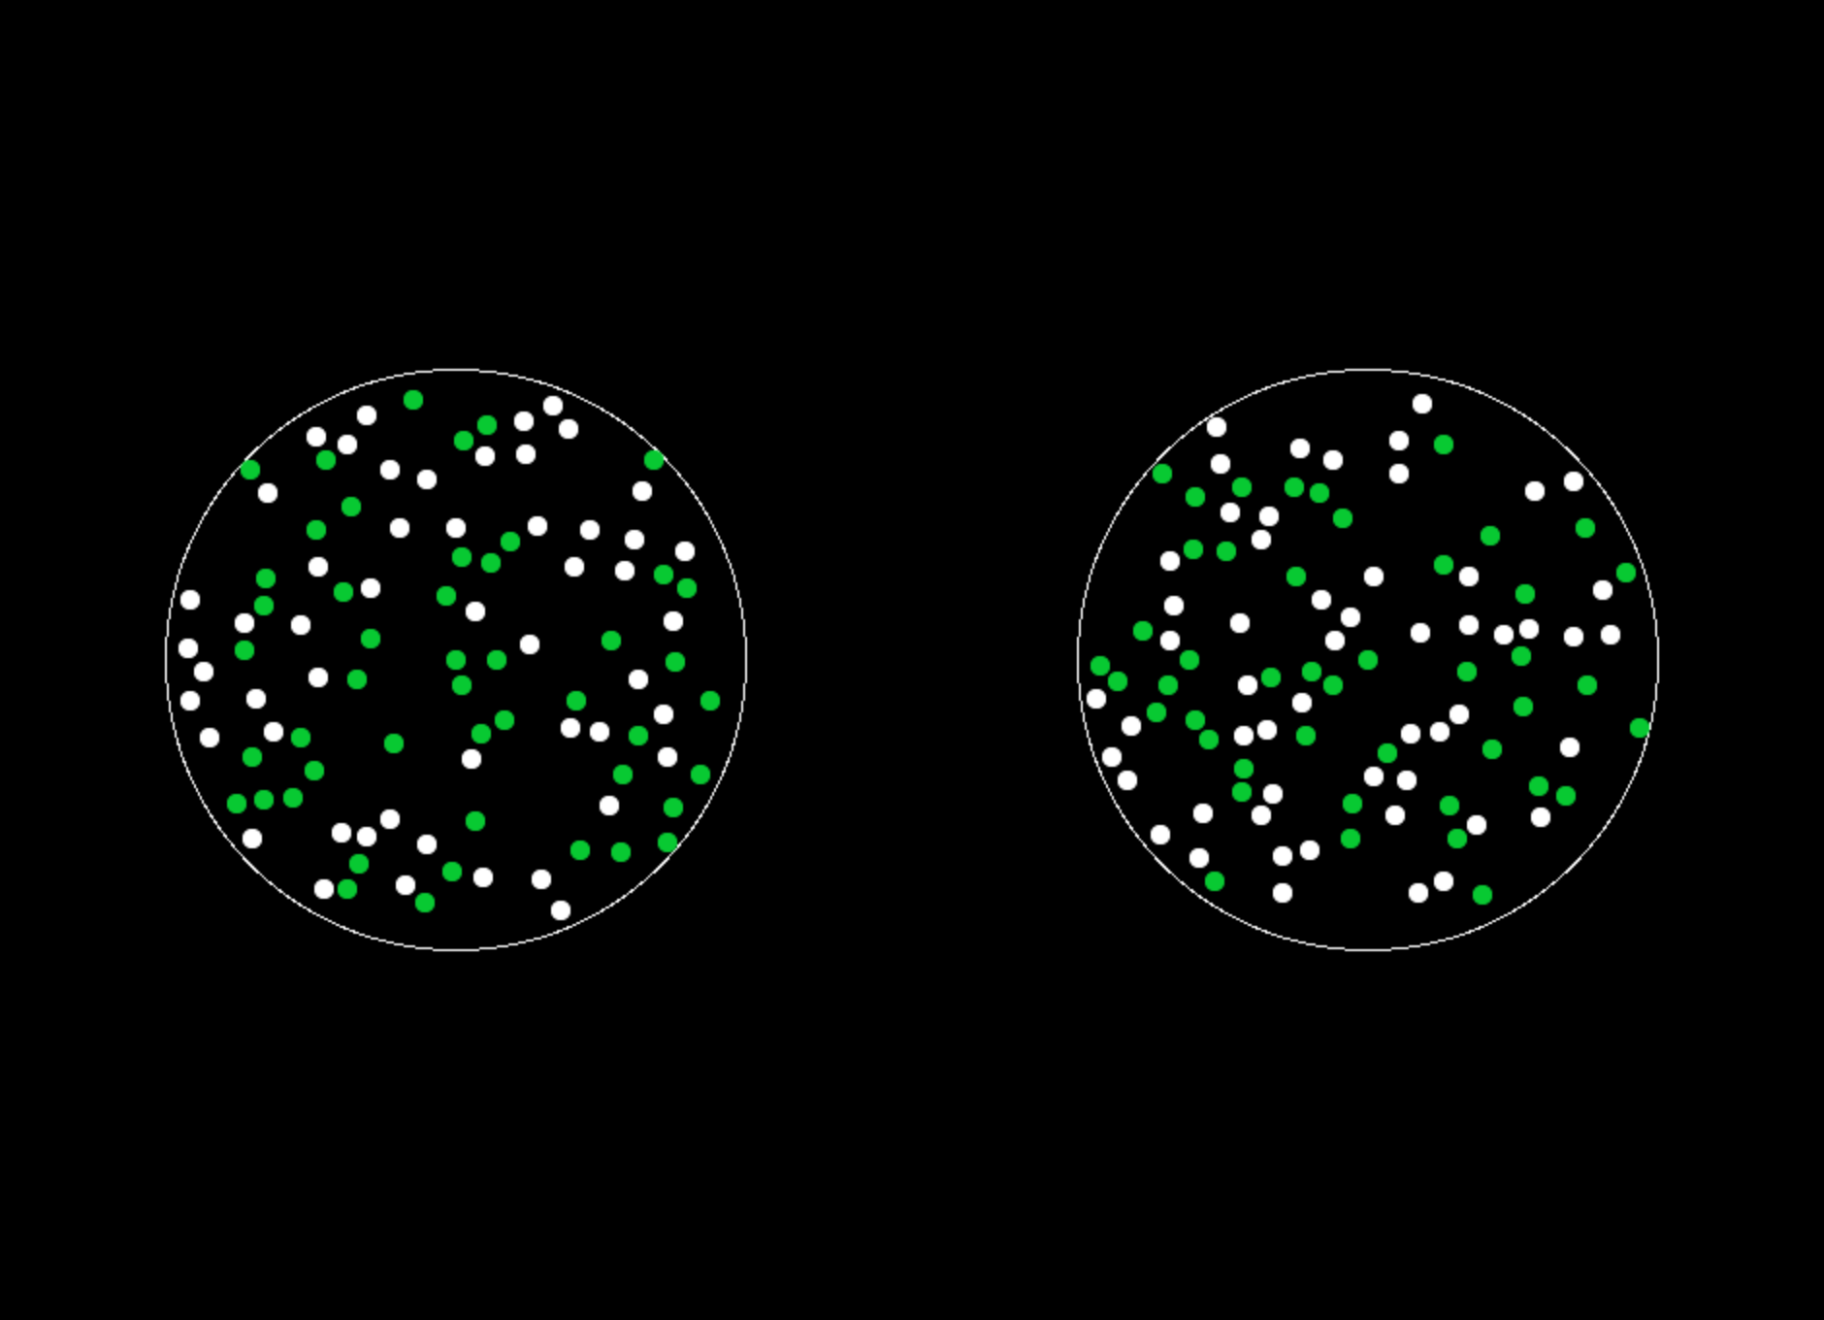
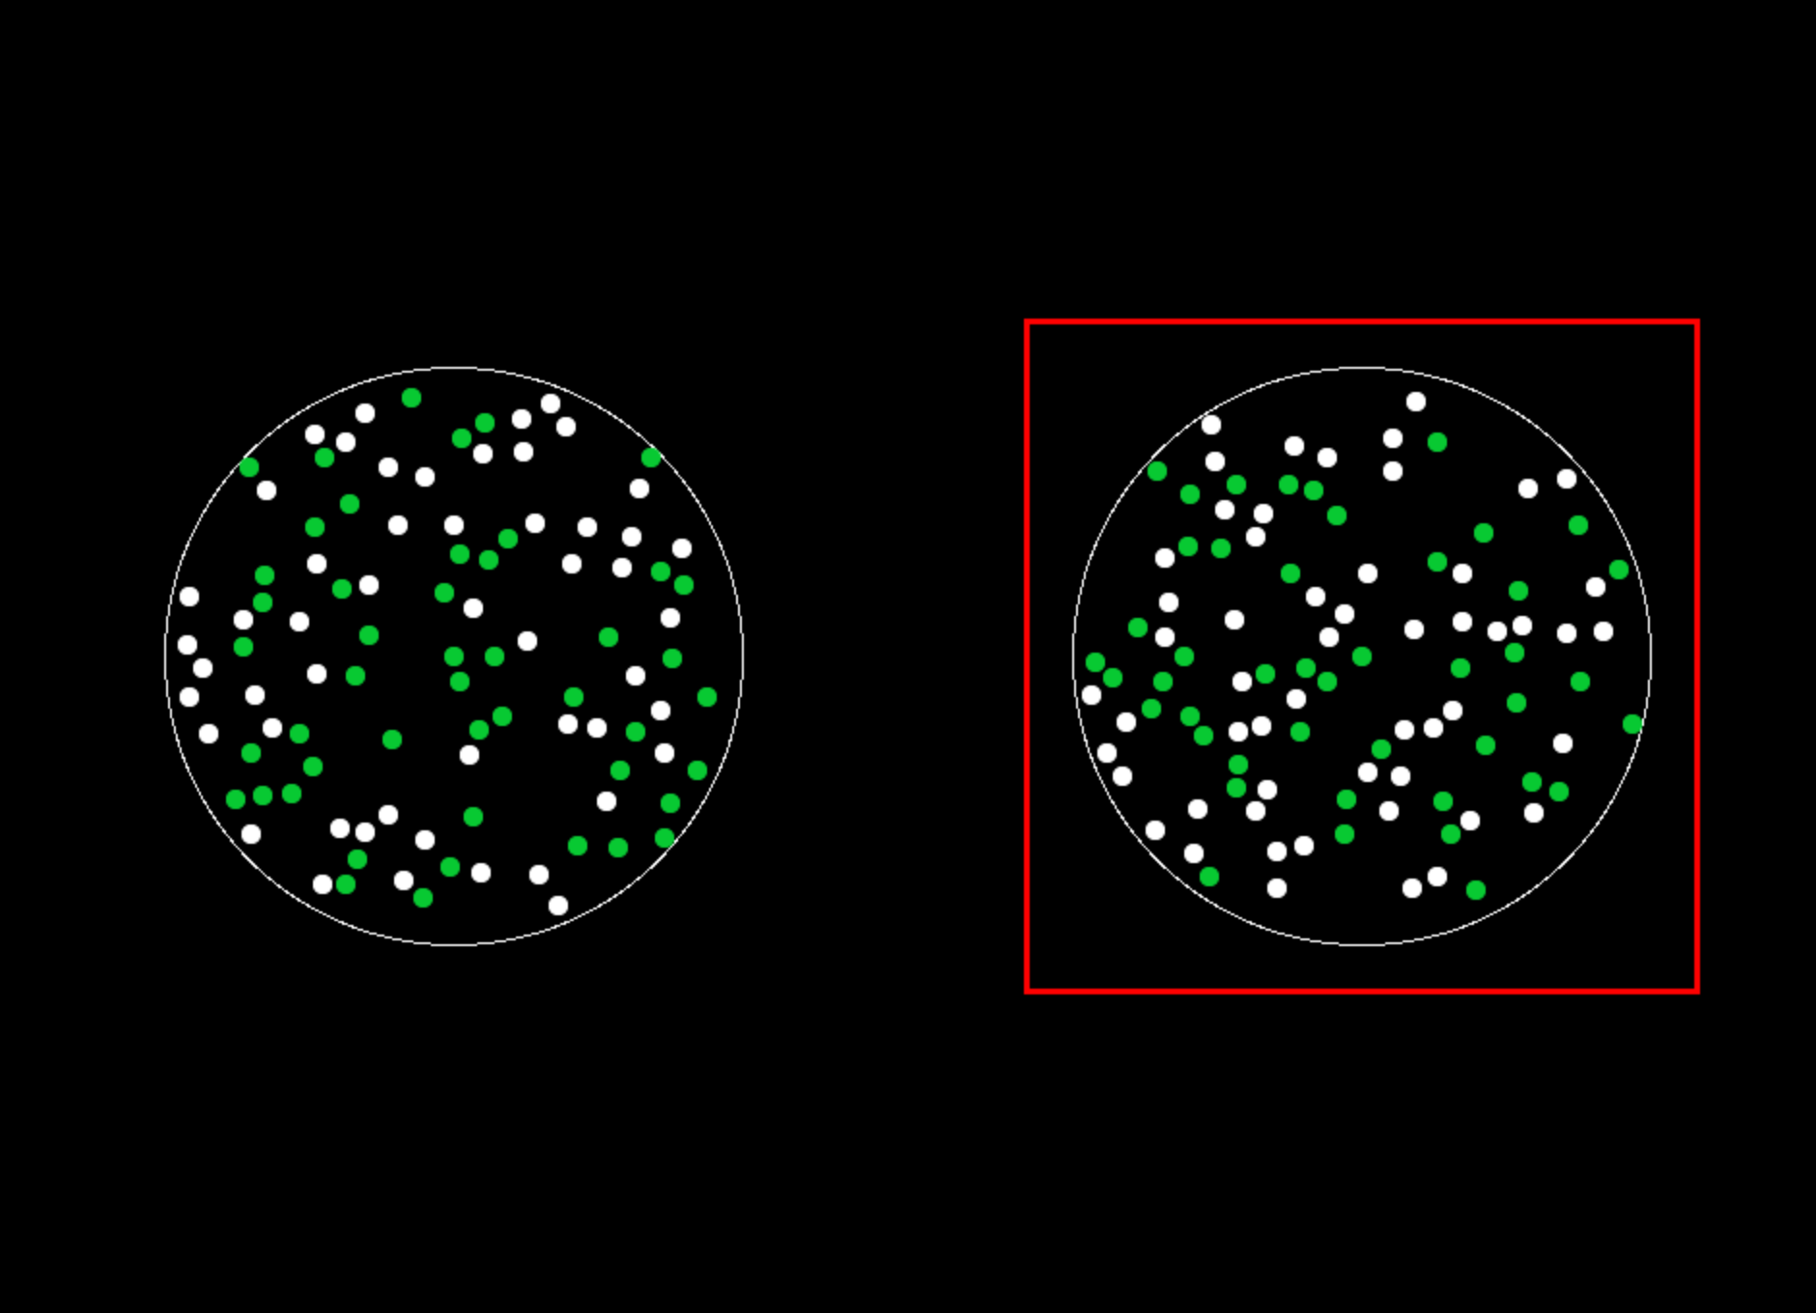

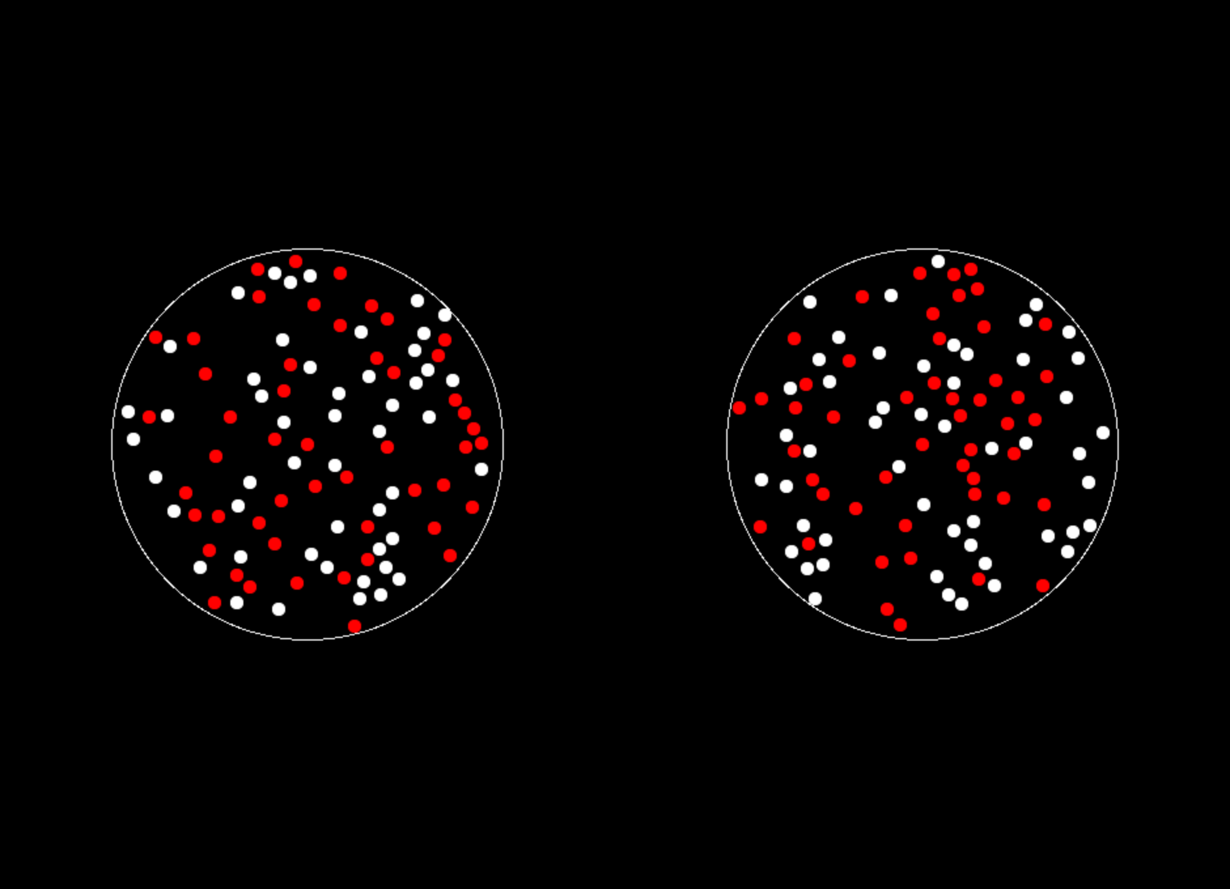
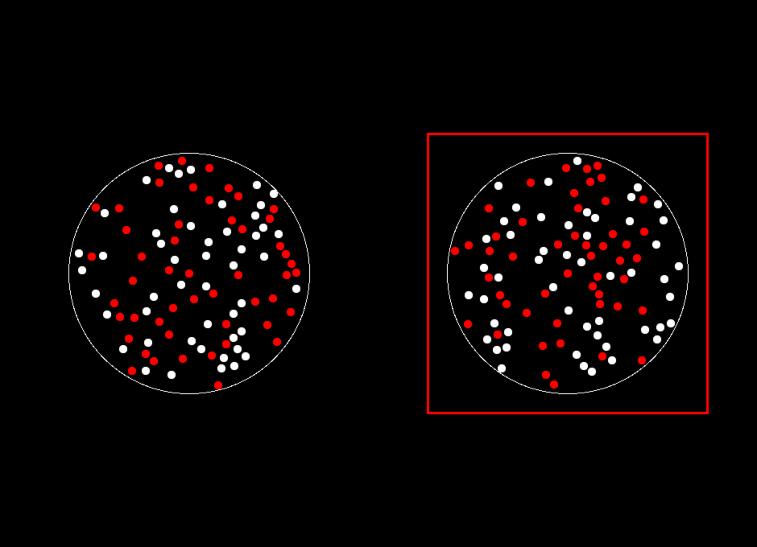
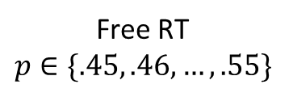
Study #1: “Dots”
N=35
400 trials
Gain
Loss
ITI
1 s
Free RT
$$p∈\{.45, .46, …, .55\}$$
Feedback
1 s
Eye-tracking

Slide 14
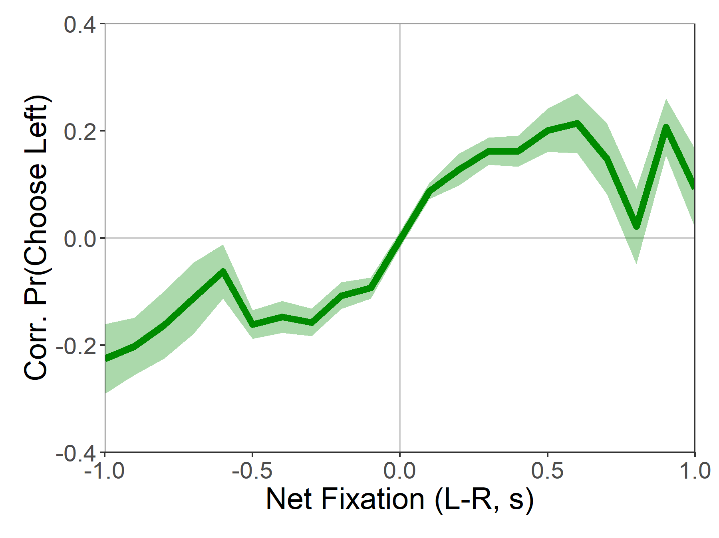
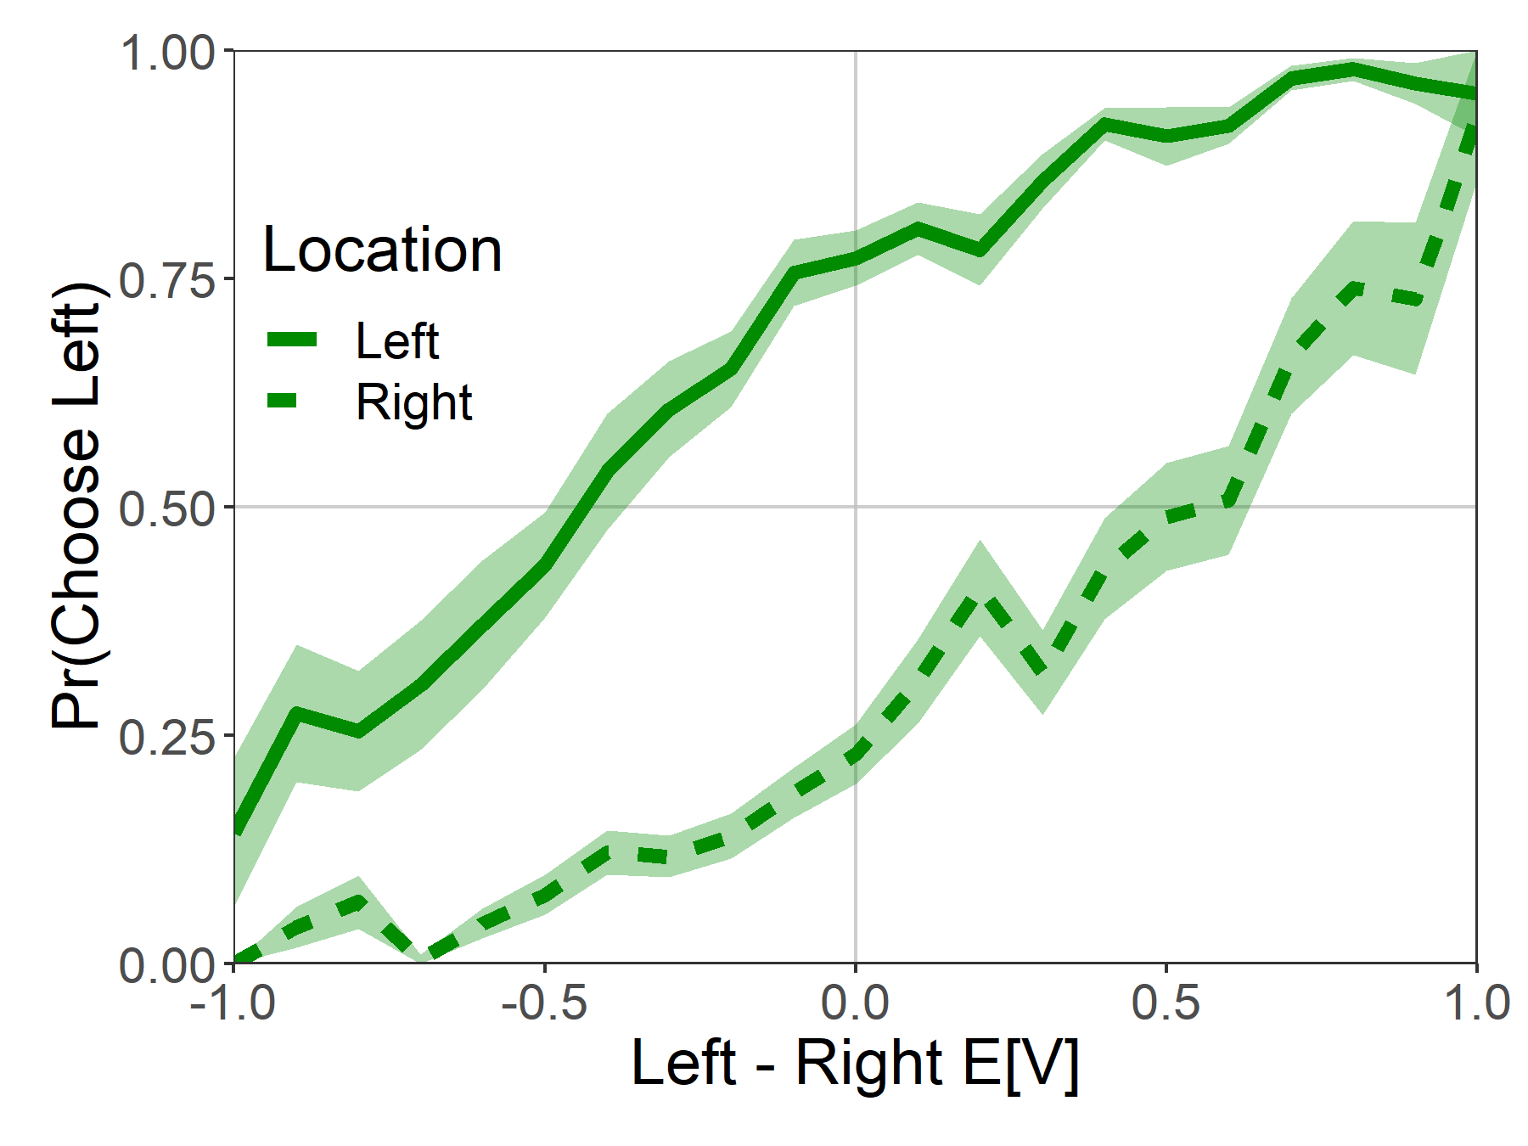
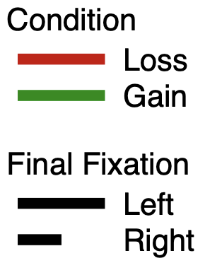
Attentional Choice Biases

Slide 15
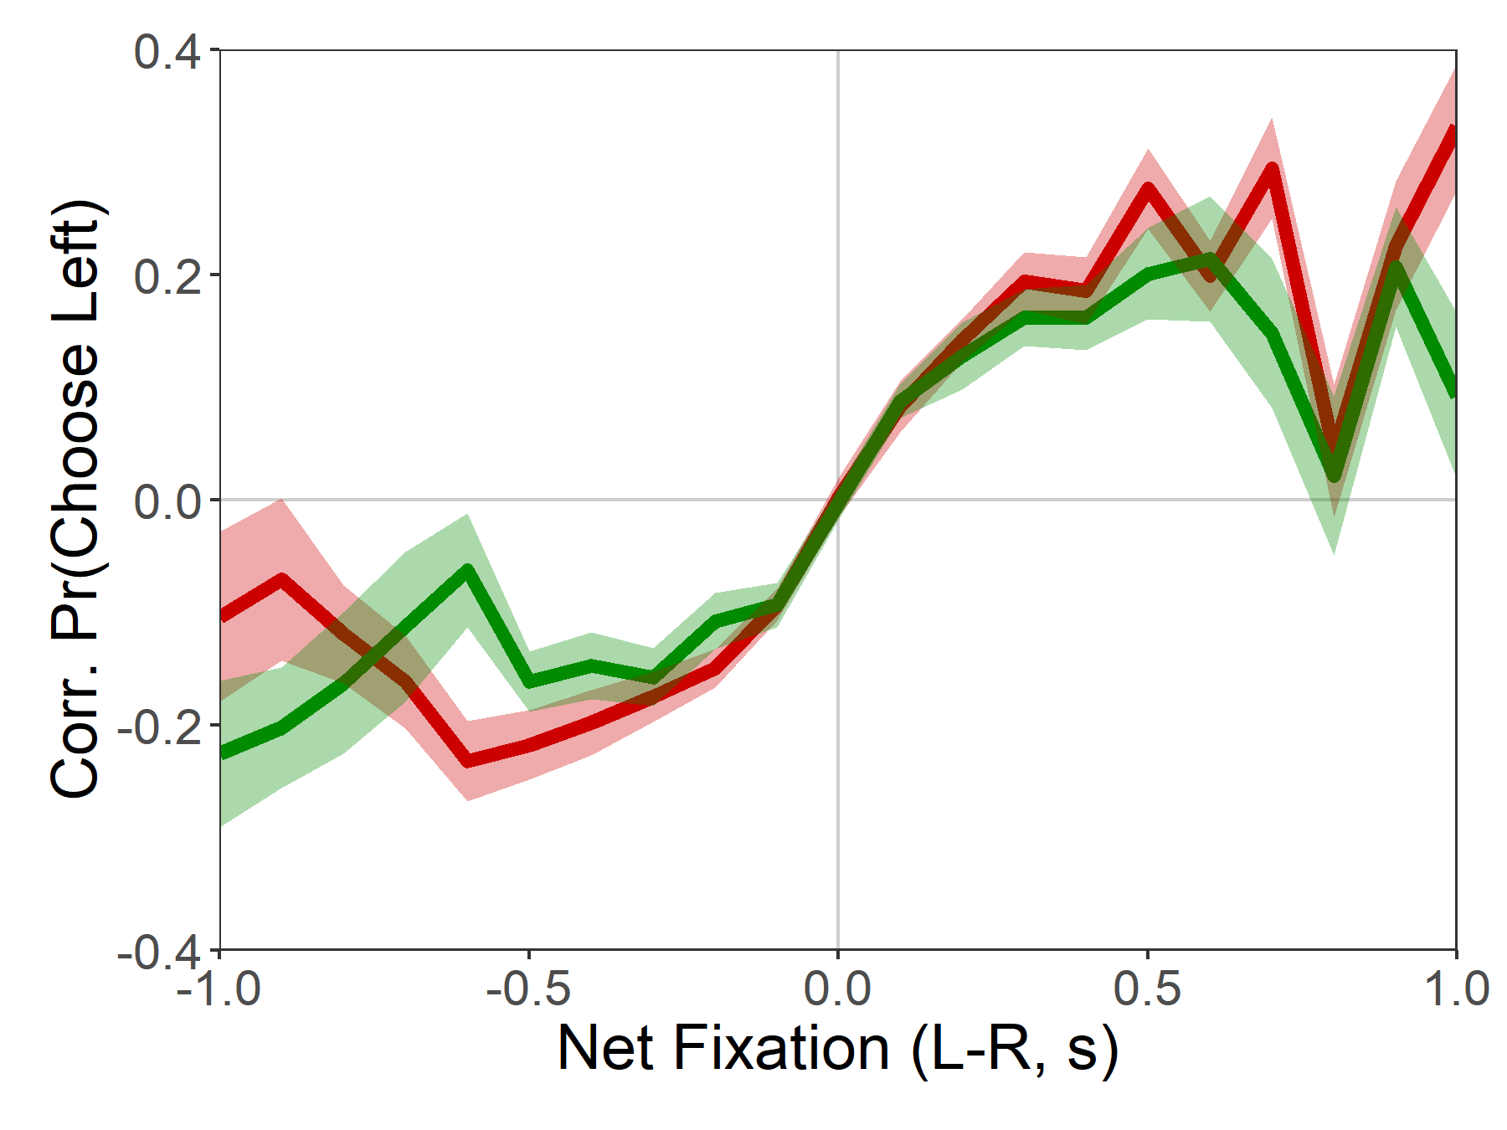
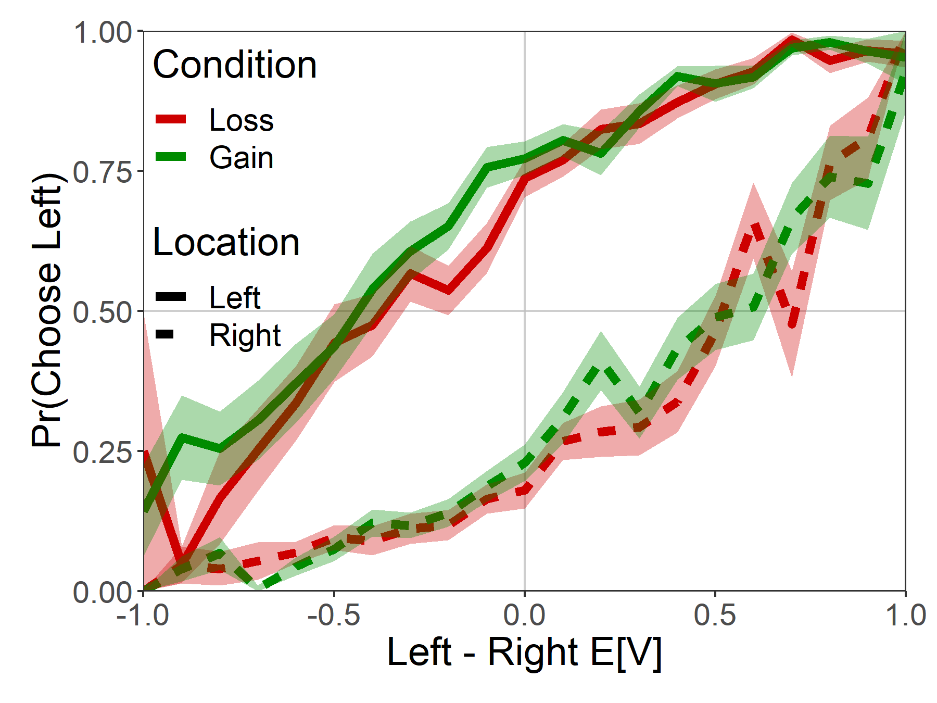
Attentional Choice Biases
Do NOT Flip!

Slide 16
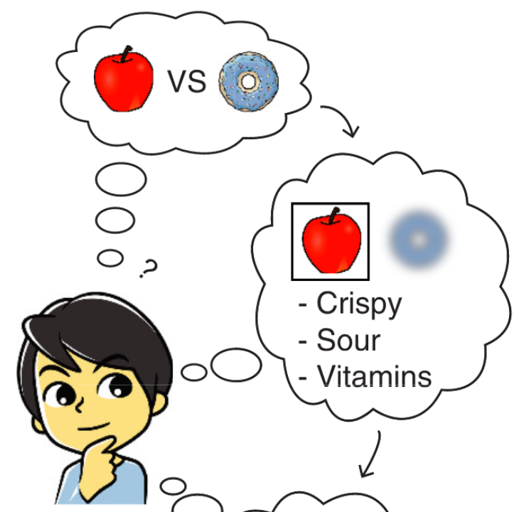
Count green
Count white
Thinking boy from Jang, Sharma, Drugowitsch (2021, eLife)
Brenden Eum

Slide 17
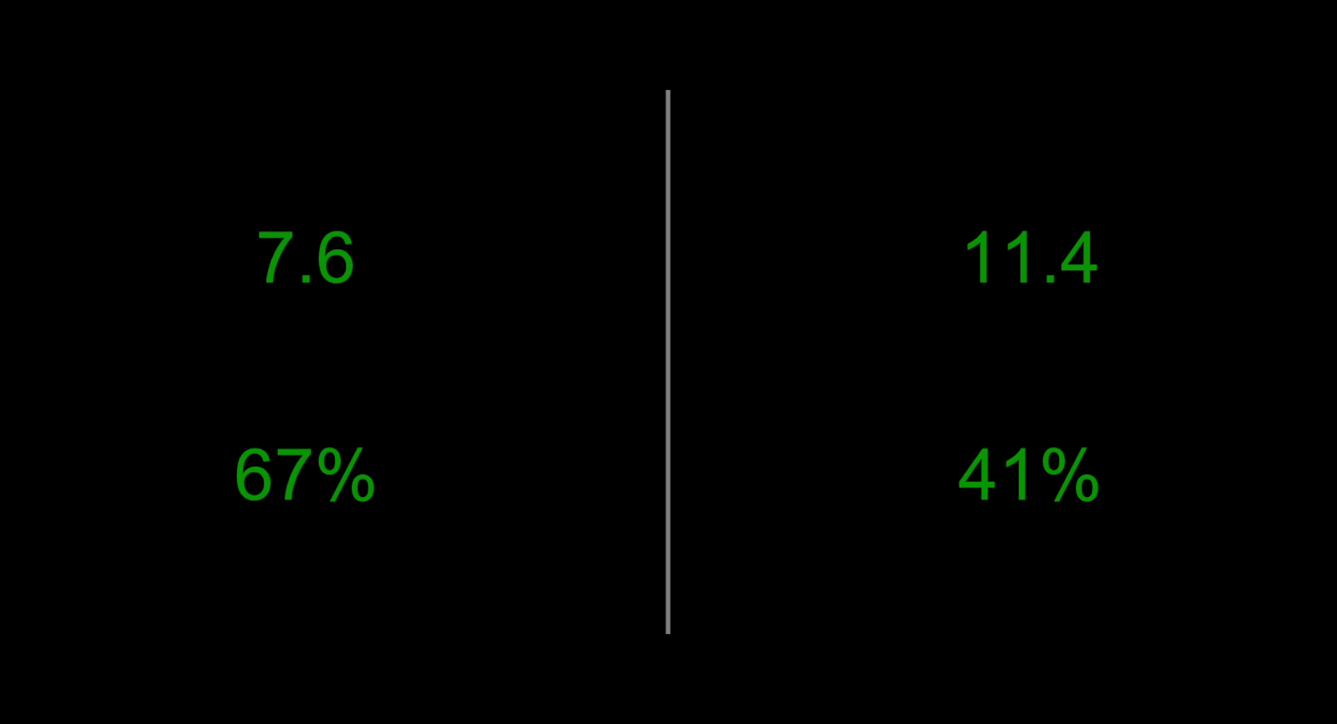
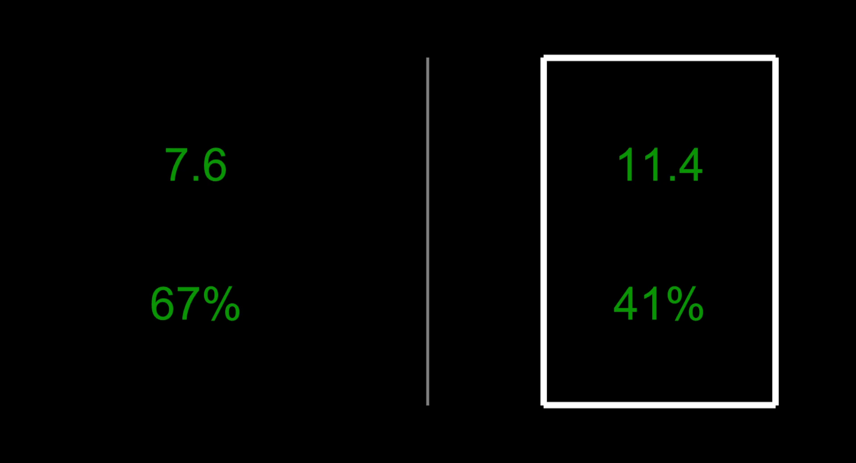
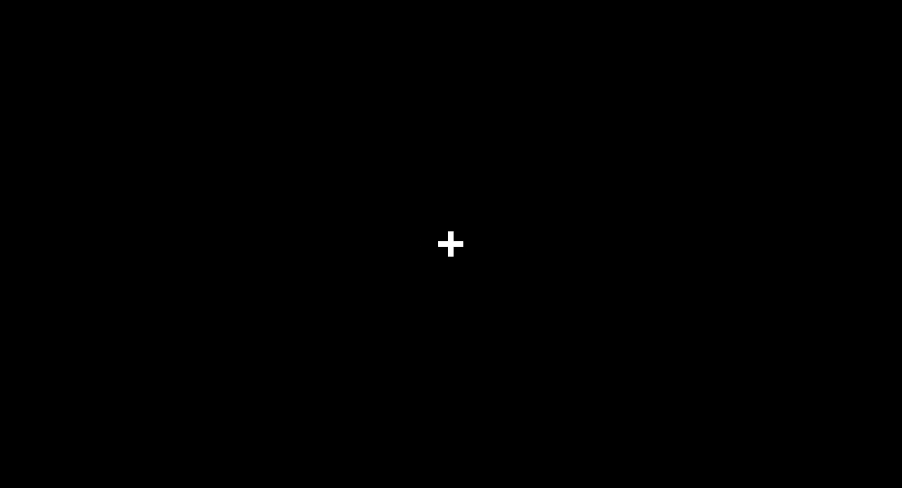
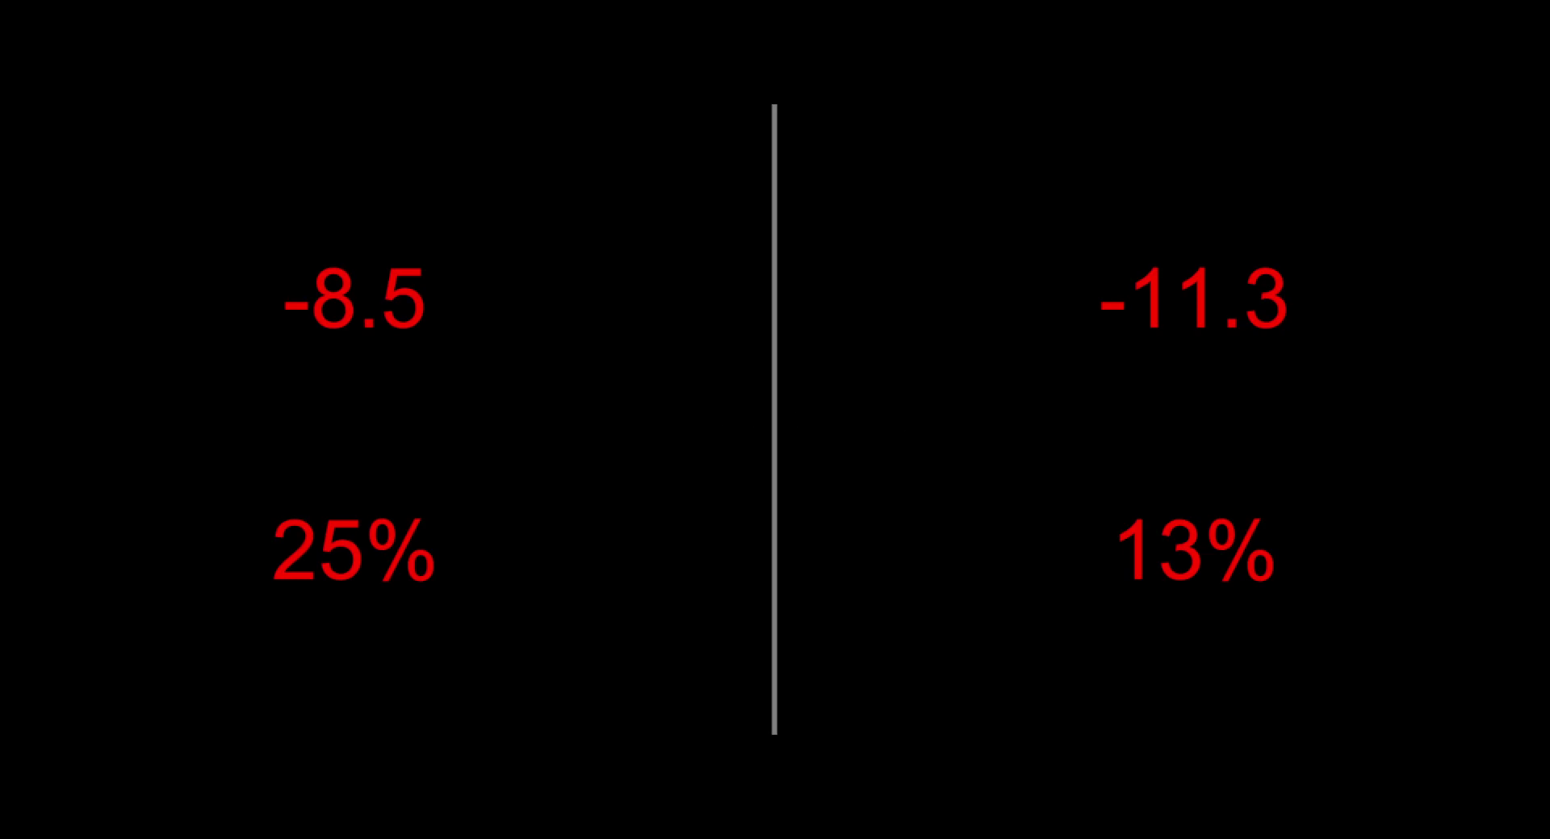
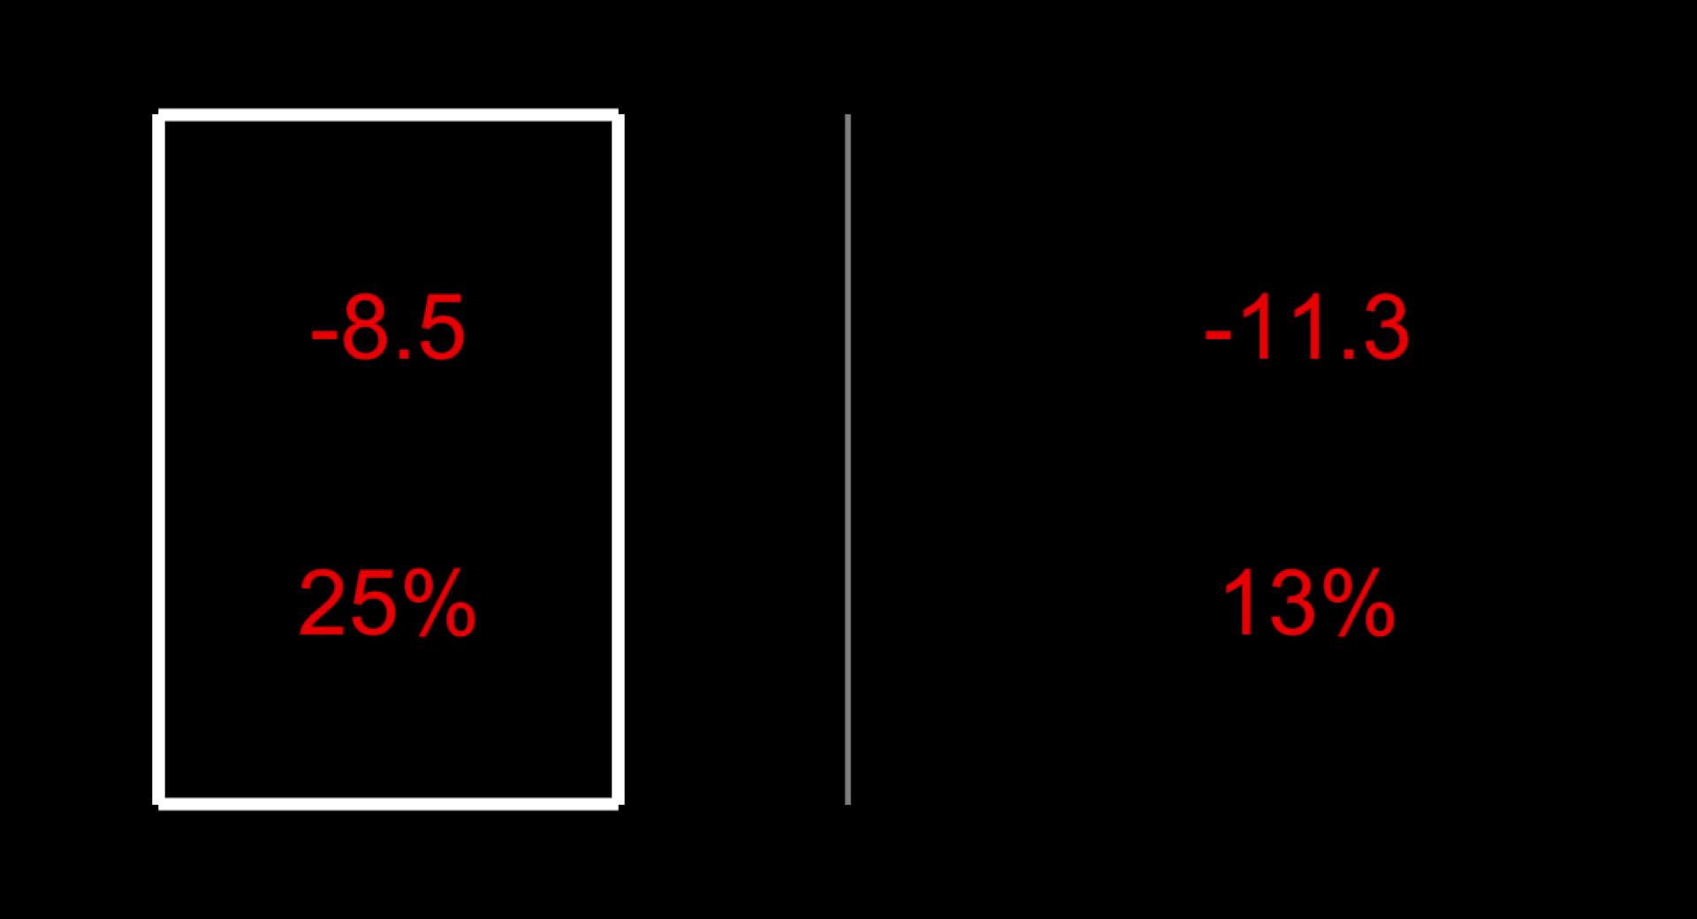
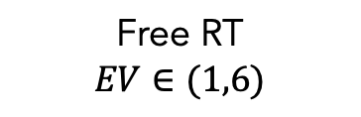
Study #2: “Numeric”
N=26
340 trials
Gain
Loss
ITI
1 s
Free RT
$$EV∈(1,6)$$
Feedback
1 s
Eye-tracking

Slide 18

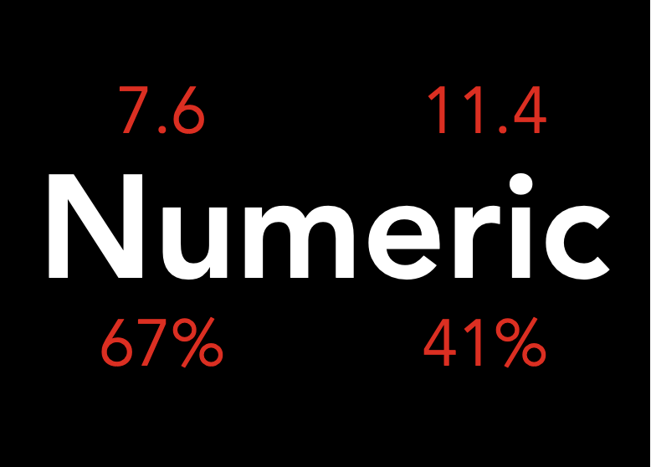
Attentional Choice Biases
STILL Do Not Flip!

Slide 19
Roadmap
Predictions of the aDDM in choices between losses
Attentional choice biases don’t flip as predicted
Fitting the aDDM to choices between losses
A more intuitive variation of the aDDM in losses
A puzzle about the choice process in losses
Brenden Eum

Slide 20
Roadmap
Predictions of the aDDM in choices between losses
Attentional choice biases don’t flip as predicted
Fitting the aDDM to choices between losses
An intuitive variation of the aDDM
A puzzle about the choice process in losses
Brenden Eum

Slide 21
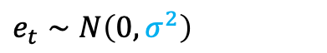
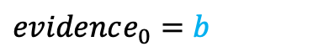


aDDM Parameter Estimates
*Each point is a single subject.
$evidence_{t}=evidence_{t−1}+μ_{t}+e_{t}$
Looking left: $μ_{t}=d(V_{L}−θV_{R})$
Looking right: $μ_{t}=d(θV_{L}−V_{R})$
$$e_{t}∼N\left(0, σ^{2}\right)$$
$evidence_{0}=b$
See Enkavi, Goldman, Yang, Rangel (in prep) for aDDM toolbox in Julia. It’s super fast!

Slide 22
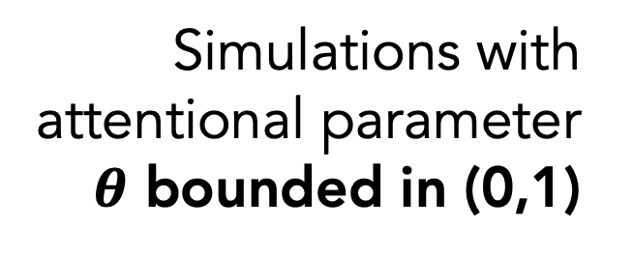
Observed Data
(Dots Task)
Simulations with attentional parameter
$θ$ bounded in (0,1)
Brenden Eum

Slide 23
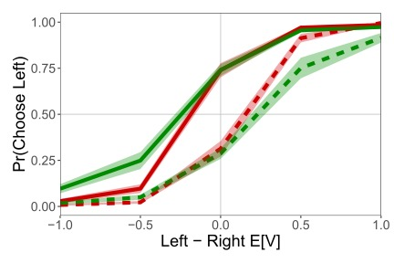
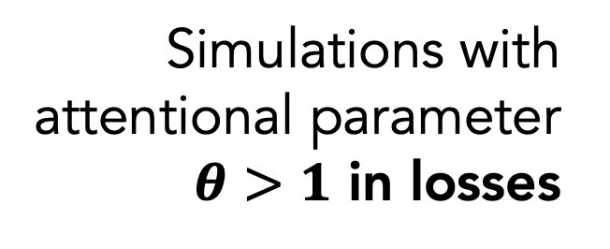
Observed Data
(Dots Task)
Simulations with attentional parameter
$θ>1$ in losses
Brenden Eum

Slide 24


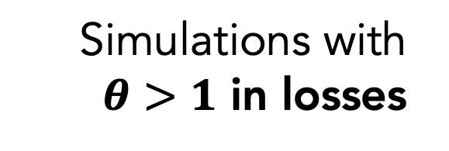
Observed Data
(Dots Task)
Intuition Police:
What the heck does $θ>1$ intuitively mean?
Simulations with
$θ>1$ in losses
Brenden Eum

Slide 25
Intuition for $θ∈(0,1)$
V( ) = V( )
See Jang, Sharma, Drugowitsch (2021, eLife); Callaway, Rangel, Griffiths (2021, PLoS Comput Bio)
Brenden Eum

Slide 26
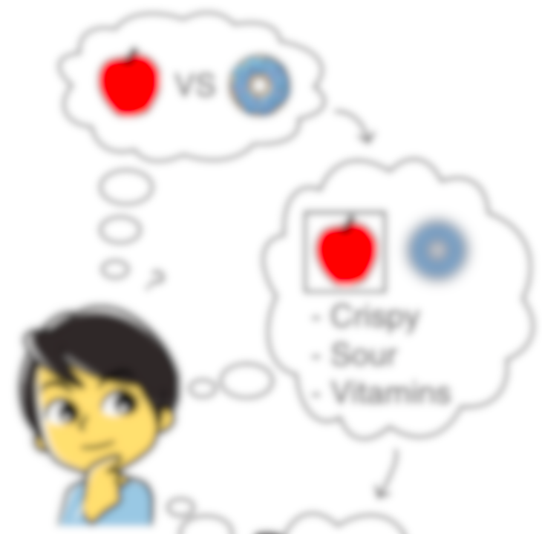

Intuition for $θ∈(0,1)$
V( ) sample
Evidence
V( ) = V( )
Time
V( ) sample
See Jang, Sharma, Drugowitsch (2021, eLife); Callaway, Rangel, Griffiths (2021, PLoS Comput Bio)
Brenden Eum

Slide 27
Intuition for $θ>1$
V( ) sample
V( ) sample
See Jang, Sharma, Drugowitsch (2021, eLife); Callaway, Rangel, Griffiths (2021, PLoS Comput Bio)
Brenden Eum

Slide 28
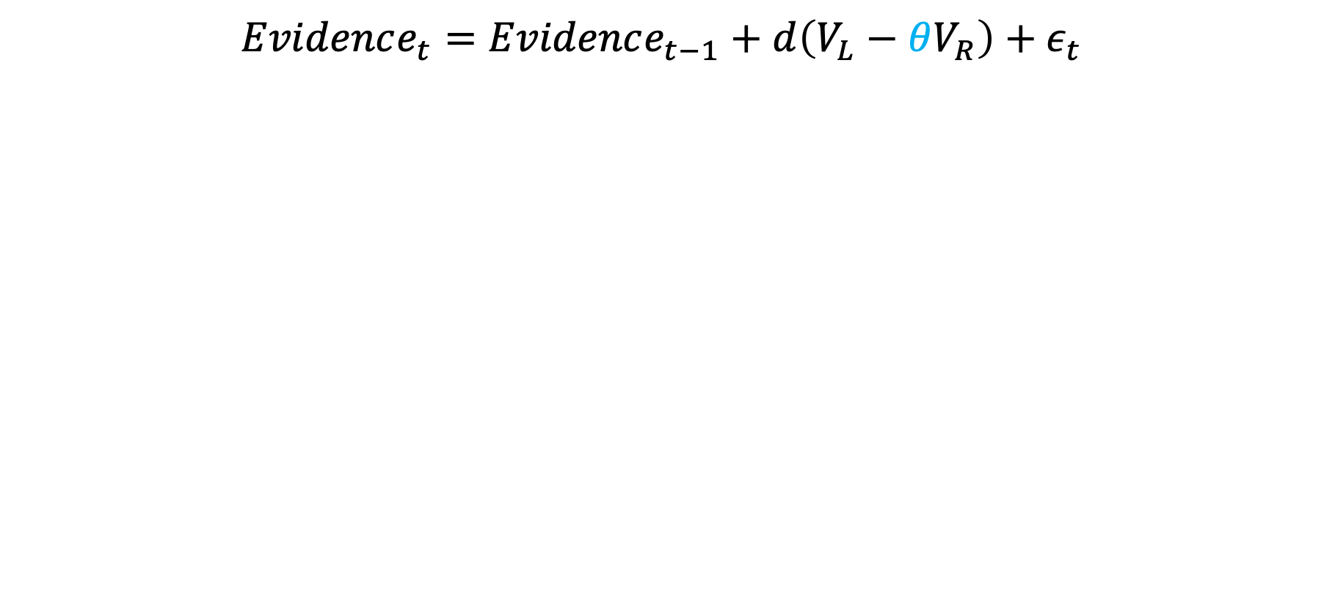
Moving Towards a More Intuitive Explanation
$$Evidence_{t}=Evidence_{t−1}+d\left(V_{L}−θV_{R}\right)+ε_{t}$$
Brenden Eum

Slide 29
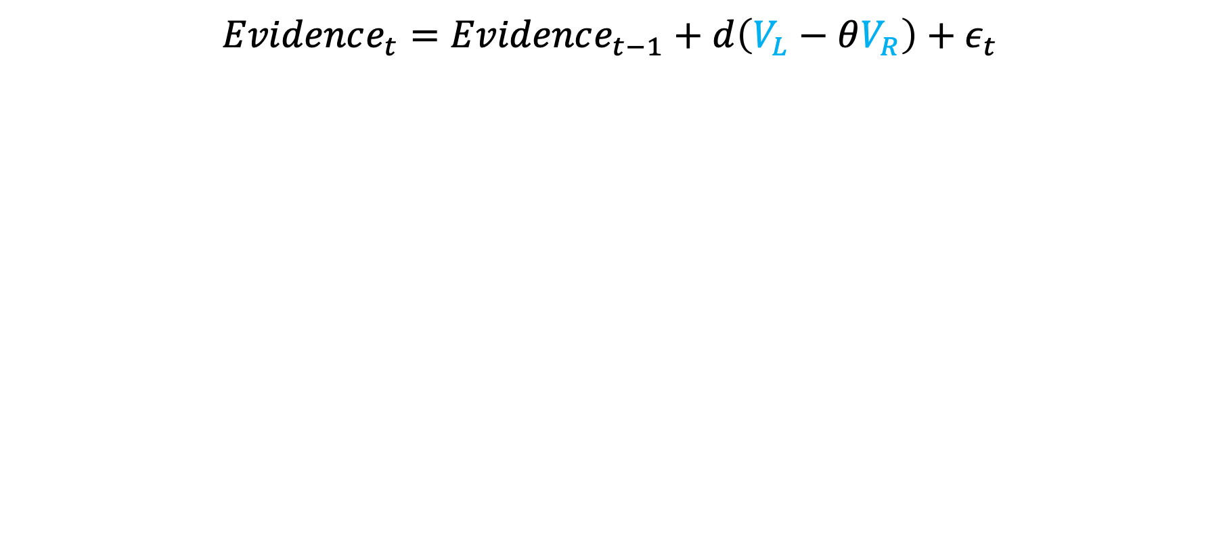
Moving Towards a More Intuitive Explanation
$$Evidence_{t}=Evidence_{t−1}+d\left(V_{L}−θV_{R}\right)+ε_{t}$$
Brenden Eum

Slide 30
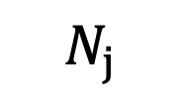
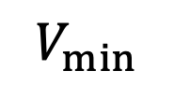
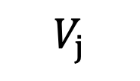
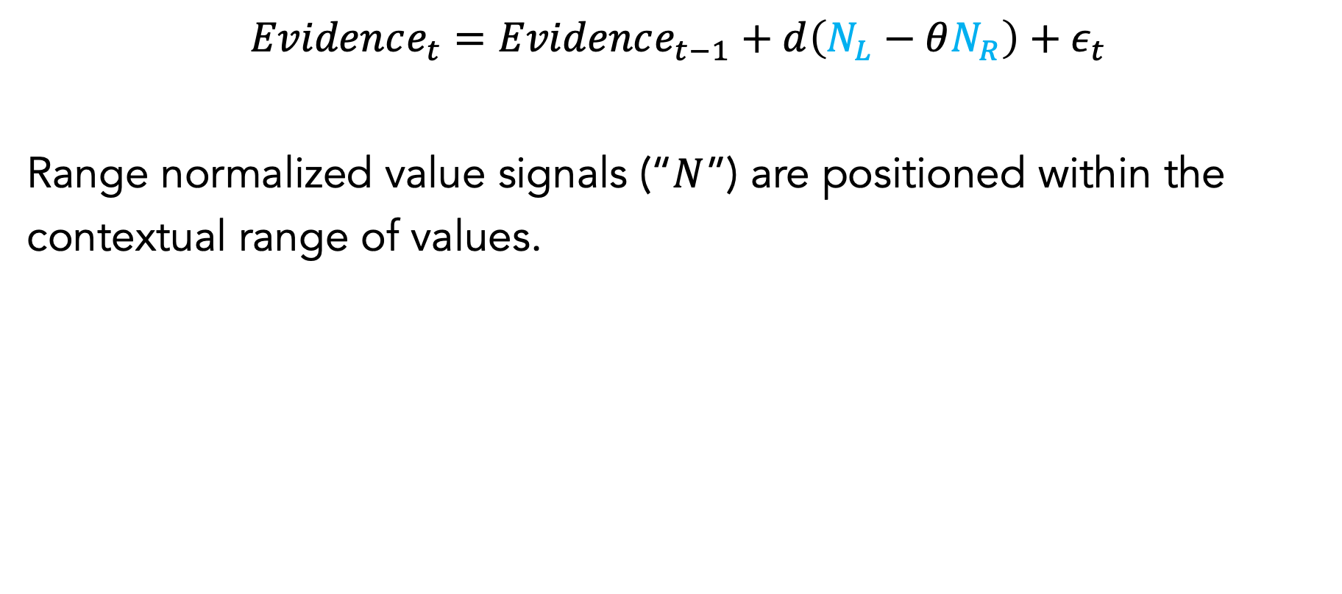



Range Normalized Evidence Accumulation
$$Evidence_{t}=Evidence_{t−1}+d\left(N_{L}−θN_{R}\right)+ε_{t}$$
Range normalized value signals (“$N$”) are positioned within the contextual range of values.
$$0$$
$$N_{j}$$
$$1$$
$$V_{min}$$
$$V_{j}$$
$$V_{max}$$
Rangel, Clithero (2012, Curr Op Bio); Padoa-Schioppa (2009, J Neurosci); See also Kim et al (2006, PLoS Bio), Burke et al (2016, J Neurosci)
Brenden Eum

Slide 31

Range Normalized Evidence Accumulation
$$Evidence_{t}=Evidence_{t−1}+d\left(N_{L}−θN_{R}\right)+ε_{t}$$
Range normalized value signals (“$N$”) are positioned within the contextual range of values.
$$N_{j}=\frac{V_{j}−V_{min}}{V_{max}−V_{min}}∈(0,1)$$
Rangel, Clithero (2012, Curr Op Bio); Padoa-Schioppa (2009, J Neurosci); See also Kim et al (2006, PLoS Bio), Burke et al (2016, J Neurosci)
Brenden Eum

Slide 32


Range Normalized Evidence Accumulation in Losses
Mean(Loss AIC)_{Range Normalized aDDM} < Mean(Loss AIC)_{Unbounded} $θ$ _{aDDM} (p=.01)
Brenden Eum

Slide 33
Observed Data
(Numeric Task)
Simulations with
Range Normalized Evidence
Brenden Eum

Slide 34
Observed Data
(Numeric Task)
In choices involving negative-outcome lotteries, people may be accumulating range normalized evidence instead of context-independent value samples.
Simulations with
Range Normalized Evidence
* “absolute" means context-independent, NOT taking the absolute value of the value signal [see Rangel, Clithero (2012, Curr Op Bio)]
Brenden Eum

Slide 35


Are people always accumulating range normalized information in losses?
Aversive
$θ∈(0,1)$
Negative value signals, not range normalized.
Armel, Beaumel, Rangel (2008, JDM)
Brenden Eum

Slide 36
Are people always accumulating range normalized information in losses?
$θ∈(0,1)$
Negative value signals, not range normalized.
PUZZLE:
When do people switch to accumulating range normalized evidence?
Is there something about the nature of the stimuli that causes this switch?
Armel, Beaumel, Rangel (2008, JDM)
Brenden Eum

Slide 37
Conclusion
Contrary to one of the assumptions of the aDDM, attention to an option still pushes choice towards that option, even in losses.
The aDDM with an unbounded attentional parameter and with range normalized evidence are both capable of capturing this effect, though only the latter seems to make intuitive sense.
Unbounded
Range Normalized
Puzzle: There seems to be evidence that in choices between losses, people might not always be accumulating range normalized evidence. Any ideas when they do(n’t)?
Brenden Eum

Slide 38

Additive Model of Attention
AIC in gains and losses was not significantly different from unbounded $θ$ aDDM.
It is outperformed by Range Normalized aDDM in losses (p=.03).
Mean (sd) additive attn. param. in gains = 1.25 (.79)
Mean (sd) additive attn. param. in losses = 1.48 (1.50)
Cavanagh et al (2012); Smith, Krajbich (2019)
Brenden Eum

Slide 39

Divisive Normalization
Previous studies have worked with positive rewards.
When all values are negative, divisive normalization flips the ordinal ranking of options. We look at the simplest form of divisive normalization and suggest a modification that preserves the ordinal ranking in losses:
$$If N_{k}<0 ∀k, N_{j}=−\frac{N_{j}}{\sum_{k}{N_{k}}}$$
$${\left(AIC\right)}_{divNorm}^{gains}≫{\left(AIC\right)}_{\{unbounded aDDM, rangeNorm\}}^{gains} (p≈0)$$
$${\left(AIC\right)}_{divNorm}^{losses}≪{\left(AIC\right)}_{\{unbounded aDDM, rangeNorm\}}^{losses} (p≈0)$$
Louie, Khaw, Glimcher (2013); Webb, Glimcher, Louie (2021)
Brenden Eum

